Slide 1
Introduction to Git, GitHub & Version Control
Notes:
Good morning good afternoon good evening
Depending on where in the world you might be my name is ..
I’m a ..
As we go through this if you have questions feel free to go ahead and ask them.
One thing to note is that as we go through this if somebody asks a question, I may hold off for a couple of minutes to answer that either to try to keep with the flow or because we are going to answer the question a little bit later but please don’t be shy don’t be afraid at all to ask your questions.

Slide 2


@mmsalmanfaris
Notes:
Mentioning git some of you may think it’s related to GitHub but that’s not true as Git is a version control tool which doesn’t require GitHub to work
While GitHub is a cloud platform for hosting and sharing Git Projects.

Slide 3
Agenda
What is Git & GitHub?
Understanding the core Concepts.
Working with Local & Remote repositories.
Design & Host Portfolio
@mmsalmanfaris

Slide 4




What is Version Control?
When
Who
Where
@mmsalmanfaris
Notes:
To answer this question let me tell you a little story.
Once upon a time, there were two friends playing a game together this game consists of the world map and a small pieces that you use to conquer a piece of land.
Each player starts moving his pieces and the player that conquers the biggest piece of land wins.
The game takes a lot of time as the players are trying to conquer the whole world so, sometimes they pause the game and continue playing next day.
Instead of restarting the game each time they thought of a nice solution which is to keep track of the game state by taking an image of the game board each time they stop playing.
This image has the time included in it, who took the image, and the state and location of game pieces in the image which insured that they always have a safe point they can get back to.

Slide 5
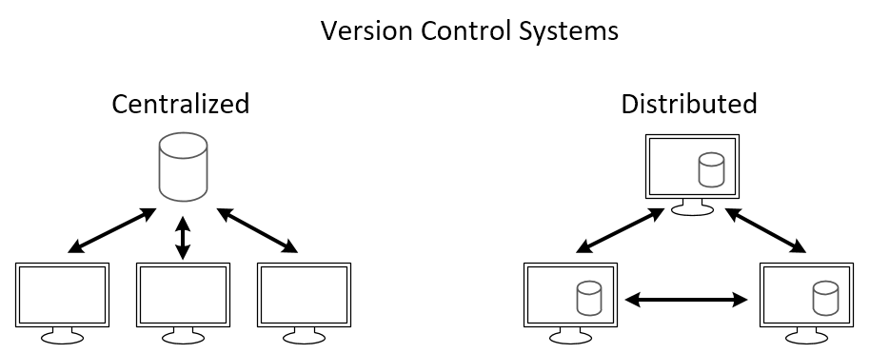
Version Control Systems (VCS)
Centralized (CVCS)
Distributed (DVCS)
@mmsalmanfaris
Notes:
Centralized, only one device has everything (each device has his own piece of the centralized code)
Distributed, each device has the same version of the code (all the devices are contributing to it at the same time)

Slide 6
Version Control System Video
@mmsalmanfaris
Notes:
Centralized, only one device has everything (each device has his own piece of the centralized code)
Distributed, each device has the same version of the code (all the devices are contributing to it at the same time)

Slide 7
Most Popular Version Control Systems
Git
Subversion
Mercurial
@mmsalmanfaris
Notes:
The centralized and distributed version control systems is a concept that some tools are built on.
Git uses a distributed version control system.
Git uses a centralized version control system.
Git uses a distributed version control system.

Slide 8
How to get Git?
MacOS / Windows
Go to git-scm.com/downloads
Download the software for Mac/Windows
Install Git, choosing all of the default options
Linux
$ sudo apt-get install git
@mmsalmanfaris

Slide 9
git-cheat-sheet-education (github.com)
@mmsalmanfaris
Notes:
All of these terminologies are actually used while working with git, but you don’t need to learn about all of them at the beginning but If you prefer learning everything before starting the practical part this git cheat sheet is perfect for you.

Slide 10
Create GitHub Account
@mmsalmanfaris
Notes:
All of these terminologies are actually used while working with git, but you don’t need to learn about all of them at the beginning but If you prefer learning everything before starting the practical part this git cheat sheet is perfect for you.

Slide 11
First-Time Git Configuration
# sets up Git with your name
git config --global user.name "<Your-Full-Name>"
# sets up Git with your email
git config --global user.email "<your-email-address>"
# ensures that Git output is colored
git config --global color.ui auto
@mmsalmanfaris

Slide 12
Working with a Local Repository
Create a Git Local Repository.
Make Changes, add, and commit them.
Review the repository’s history.
@mmsalmanfaris
Notes:
All of these terminologies are actually used while working with git, but you don’t need to learn about all of them at the beginning but If you prefer learning everything before starting the practical part this git cheat sheet is perfect for you.

Slide 13
Initializing a Local Git Repository
$git init
Common terminal commands
$ls - used to list files and directories
$mkdir - used to create a new directory
$cd - used to change directories
$rm - used to remove files and directories
$pwd - used to print working directory
$touch - used to create and modify files
$start - used to open files or directories
@mmsalmanfaris

Slide 14

How does Git work?
Working Directory
Staging Area
Local Repository
$ git add index.html
$ git commit –m “Message”
Notes:
And it will move our file to the staging area or the staging index which is the intermediate place that we have talked about.
In order to do the next step which is moving the file to the local repository you have to use a command called git commit which makes our changes saved in the git history.
So, to make our changes there we use git commit and we give it a message.
For Example, “Message” any message you want but this message is really important, and we are going to get back to that in another slide but for now there is a command called git commit and we give it a dash m small to specify a specific message, and then a double quotation inside it our message.

Slide 15
Git Add
$ git add <file1> <file2> … <fileN>
$ git add .
This command moves your changes to the staging area.
@mmsalmanfaris

Slide 16
Git Commit
$ git commit –m “Initial commit”
This command moves your changes to the local repository.
Try to always write your commit message imperatively.
@mmsalmanfaris

Slide 17
Reviewing the Repository’s History
$ git status
On branch master
Your branch is up-to-date with 'origin/master’.
There is nothing to commit; the working directory clean
This command displays the status of the working directory and the staging area.
@mmsalmanfaris

Slide 18
Reviewing the Repository’s History
$ git log
This command will show you the history of changes in the repository.
the SHA
the author
the date
the commit message
$ git log --oneline
@mmsalmanfaris

Slide 19
Working with a Remote Repository
Create a GitHub repository and clone it.
Make changes and push to GitHub.
Make changes and pull from GitHub.
Fork a repository and make a pull request.
@mmsalmanfaris
Notes:
All of these terminologies are actually used while working with git, but you don’t need to learn about all of them at the beginning but If you prefer learning everything before starting the practical part this git cheat sheet is perfect for you.

Slide 20
How does Git work?
Working Area
Staging Area
Local Repository
Remote Repository
$ git add index.html
$ git commit –m “Message”
$ git push
$ git pull
Notes:
And it will move our file to the staging area or the staging index which is the intermediate place that we have talked about.
In order to do the next step which is moving the file to the local repository you have to use a command called git commit which makes our changes saved in the git history.
So, to make our changes there we use git commit and we give it a message.
For Example, “Message” any message you want but this message is really important, and we are going to get back to that in another slide but for now there is a command called git commit and we give it a dash m small to specify a specific message, and then a double quotation inside it our message.

Slide 21
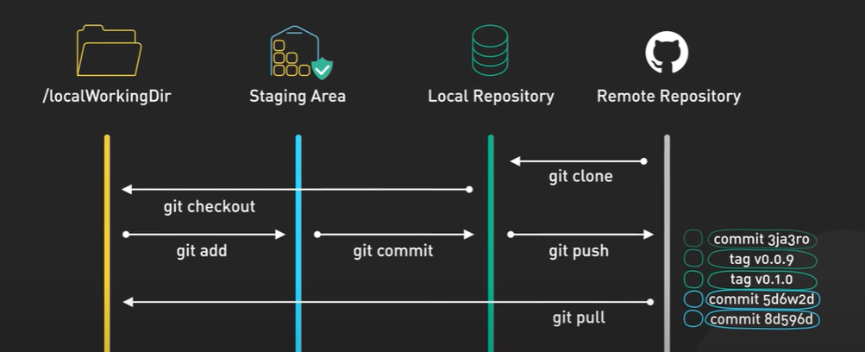
Notes:
And it will move our file to the staging area or the staging index which is the intermediate place that we have talked about.
In order to do the next step which is moving the file to the local repository you have to use a command called git commit which makes our changes saved in the git history.
So, to make our changes there we use git commit and we give it a message.
For Example, “Message” any message you want but this message is really important, and we are going to get back to that in another slide but for now there is a command called git commit and we give it a dash m small to specify a specific message, and then a double quotation inside it our message.

Slide 22
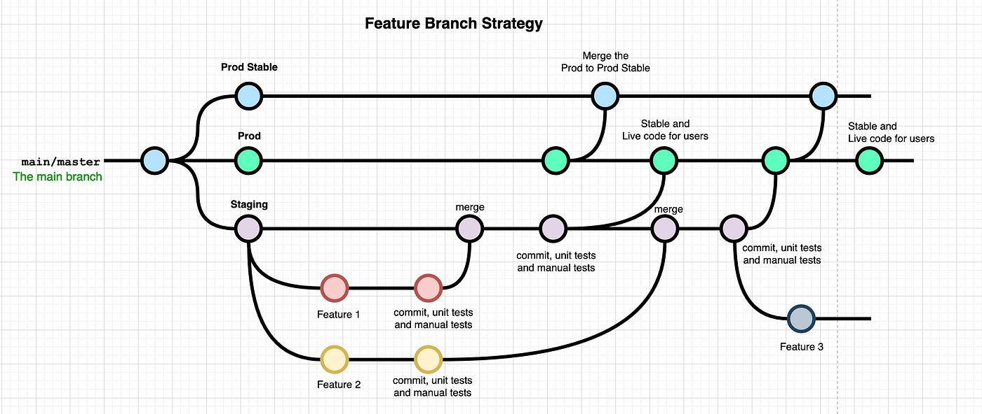
Notes:
And it will move our file to the staging area or the staging index which is the intermediate place that we have talked about.
In order to do the next step which is moving the file to the local repository you have to use a command called git commit which makes our changes saved in the git history.
So, to make our changes there we use git commit and we give it a message.
For Example, “Message” any message you want but this message is really important, and we are going to get back to that in another slide but for now there is a command called git commit and we give it a dash m small to specify a specific message, and then a double quotation inside it our message.

Slide 23

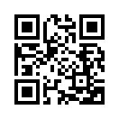
Found this helpful?
Follow for more content like this!
mmsalmanfaris
Founder Cense7 | MLSA | Undergraduate SE
Copyright information for the Slides can't be altered/removed unless contact the owner.

